Slide 1
Testing for biotic homogenization of North American and European demersal communities
Notes:
Pacific Sand Lance, Jelly fish
Ocean is a unique place to ask this question, because of enhanced dispersal over terrestrial and freshwater systems. Also, in terrestrial and freshwater systems, we often think of homogenization as involving species introductions, but in the offshore marine ecosystem, we are thinking more about asymmetric range expansions and contractions.
https://commons.wikimedia.org/wiki/File:Ammodytes_hexapterus.jpg
https://www.peakpx.com/535247/jellyfish

Slide 2





Asymmetric shifts in leading and trailing range edges
What are the implications for community structure?
Notes:
Thanks so much for taking the time to meet with me. My name is Zoe Kitchel, and I am a graduate student in Malin’s lab. My goal for today is to share my ideas, and talk about the best way for my work to complement what you all are working on and the larger FishGLOBE project
I wanted to start off by providing context for why I became interested in these questions. Much of my work so far has looked at variability in how species are shifting their ranges in response to ocean warming. One question I kept coming back to, is how does this variability in how species are shifting their ranges impact future community structure?

Slide 3
Homogenization or Differentiation
Are communities of species becoming more or less unique across space?
Differentiation
Consistent community composition
Initial Community Composition
Homogenization
Time →
Notes:
There are a number of ways variability in range shifts across species may impact community structure, but one possibility I’ve become especially interested in is homogenization or differentiation. Are communities of species becoming more or less unique across space? As a visual here, let’s call this box on the left our initial community, with each grid cell representing a site, and the color representing the community structure of that site. There are three potential trajectories over time. 1, differentiation, in which the communities look less like each other over time. On the other side we have homogeneization, where community structure of sites starts to look more similar over time, and then there’s the possibility that community structure stays similar over time.
Both differentiation and homogenization could have impacts on community functioning and productivity.

Slide 4
Introduction
“while it is clear that documenting and understanding biodiversity change is critical to these assessments, there is little agreement on how to monitor and quantify biodiversity change (Buckland 2005, Hill 2016, Proenca 2016, Vackar2012). Hillebrand 2018
It is important to note that biological diversity is a multifaceted construct, which includes (according to the CBD) “the variability among living or- ganisms [...] and the ecological complexes of which they are part; this includes diversity within species, between species and of ecosystems.” Hillebrand 2018

Slide 5
Scale and Nestedness versus Turnover Details
As expected given their complementarity30, temporal nested- ness and turnover showed opposite scaling characteristics (Fig. 1c, Supplementary Fig. 3). Assemblages separated by longer time periods were less nested within one another (negative TDΔNES) at local to intermediate scales, but TDΔNES became slightly positive toward regional and continental scales (Fig. 1c). TDTUR increased for sites separated by longer time periods (positive TDΔTUR) at all scales; however, that increase declined with spatial scale and reached zero at the global level (Fig. 1c). Such scale dependence suggests that continual turnover in assemblage composition resulting from neutral dynamics generally dominates at local scales31, while deterministic factors promoting species filtering across time are more pronounced at regional and continental than local levels. Jarzyna and Jetz 2018

Slide 6
Intro: alpha diversity
Statistically, there are two interrelated problems that render analy- ses of changes in species richness quite limited. First, species richness is a highly scale-dependent measure owing to the ubiquitous species- area relationship (Drakare, Lennon, & Hillebrand, 2006; Jost, 2007; ) Hillebrand 2018

Slide 7
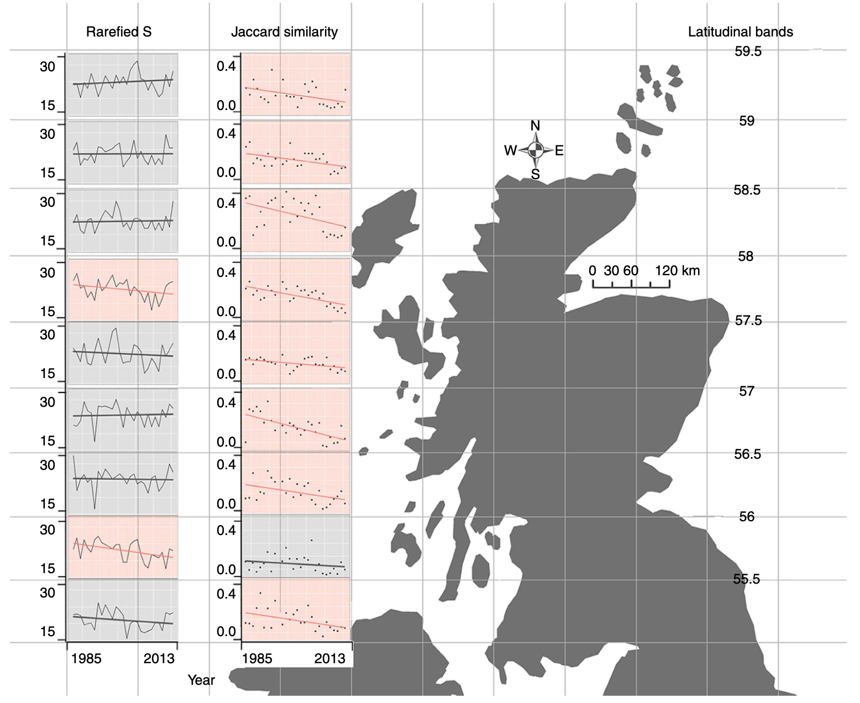
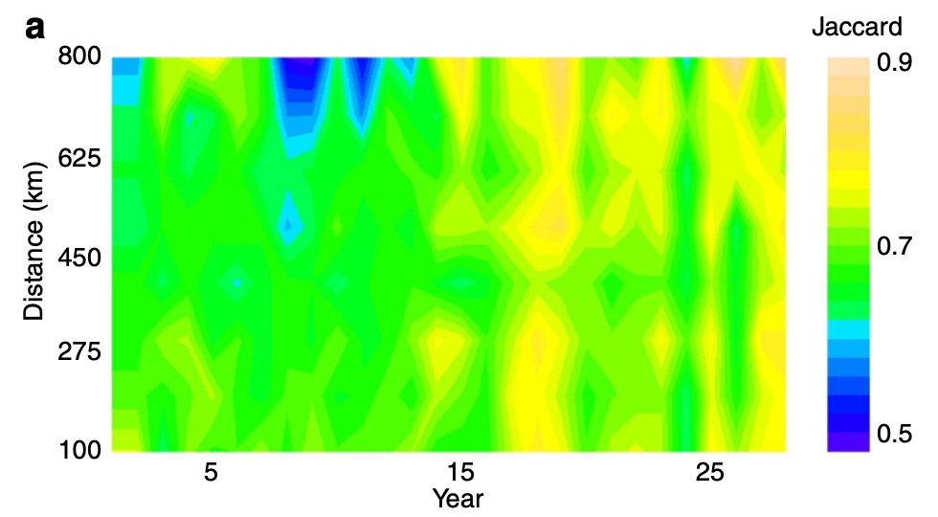
Homogenization resulting from native range shifts
Magurran et al. 2015
Notes:
In the literature, homogenization is more commonly considered in invasion literature than range shift literature, however there are some examples of studies looking at homogenization as a result of native range shifts.
This is likely the most familiar example, by Magurran et al 2015 et al looking at how beta diversity across the North Sea changes over time. While there was relatively little change in richness, there were quite dramatic shifts in the identity of the species.
My question is: Is this a common pattern? Or Unique to North Sea

Slide 8
Driving questions
Across North American and European continental shelf regions:
How does spatial beta diversity vary through time? Do we see evidence of homogenization or differentiation?
How sensitive are these patterns in beta diversity to the scale at which we look at communities?
Do taxonomic and functional spatial beta diversity of communities vary similarly through time?

Slide 9
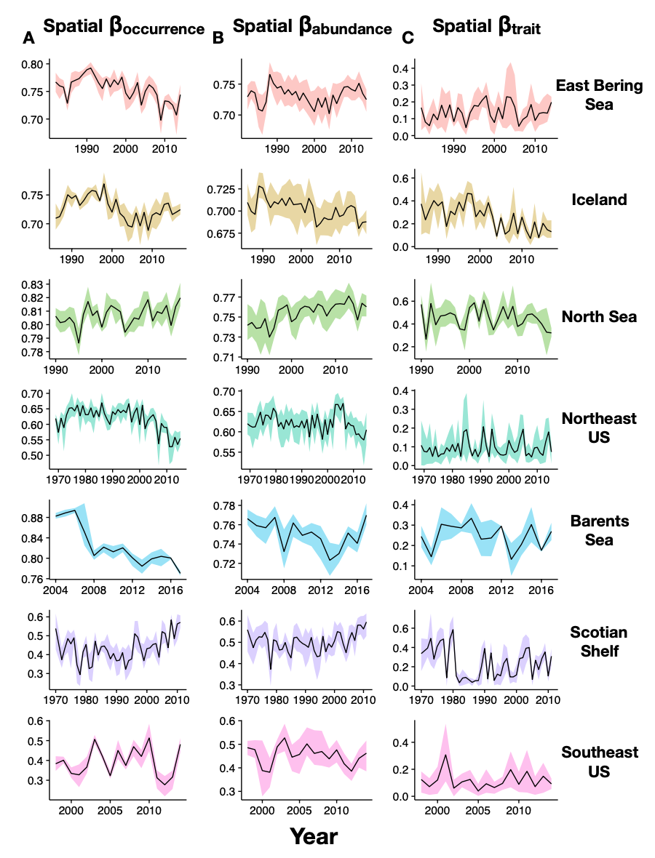
Multiple shelf regions exhibiting homogenization
Also, East Bering Sea, Iceland, North Sea, Northeast US, Barents Sea, Scotian Shelf, Southeast US
Dencker 2019
Notes:
Tim Dencker, a former PhD student in Dr. Lindegrin’s lab that I know Aurore has worked closely with was also interested in homogenization, and incorporated some of these questions into his thesis. He looked at patterns in both alpha and beta diversity over time for a variety of regions in the Atlantic and Pacific—here are just two examples.
He found that spatial beta diversity decreased significantly in four out of seven survey regions with the fastest rate of homogenization happening in the Barents Sea.
Here I just included two visuals of the 7 regions he looked at. Interesting to point out he found a contrasting pattern in the North Sea from Magurran et al, and overall, didn’t find any evidence of homogenization looking at abundances, only with occurences—which suggests that these instances of homogenization may be due to the loss of or gain of rare species, and therefore may not have large ecological consequences.

Slide 10
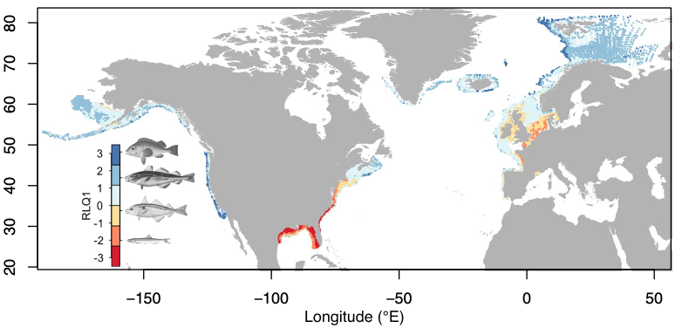
Next Steps
Incorporating additional North American regions (Aleutian Islands, Gulf of Alaska, Gulf of Mexico, West Coast US, Newfoundland)
Beukhof et al. 2019

Slide 11
Next Steps
Incorporating additional North American regions (Aleutian Islands, Gulf of Alaska, Gulf of Mexico, West Coast US, Newfoundland)
Beta diversity based on occurrence (Simpson/Sorensen) versus beta diversity based on abundance (Bray Curtis)
Are instances of homogenization due to species replacement or species loss? (partitioning beta diversity)
Sensitivity analysis across multiple scales

Slide 12
Justification for Bray Curtis
Nonetheless, the Bray–Curtis coefficient (Bray and Curtis, 1957), sometimes referred to as the Steinhaus or Odum (1950) coefficient, has been very widely employed by ecologists and environmental scientists. Bray–Curtis dissimilarity between two samples [≡ 100 − (Bray–Curtis similarity)] is defined as…. It, and related coefficients (Kulczynski, Canberra dissimilarity, a quantitative form of Ochiai, etc.—see later for definitions), which we coin the ‘Bray–Curtis family’, are implicitly motivated by the following guidelines for a dissimilarity measure.
(i)Coincidence: the measure takes the value zero only when the two samples are identical.
(ii)Complementarity: it takes its maximum value (100 or 1, the former being used here) when two samples have no species in common, irrespective of the precise abundances.
(iii)Relative invariance: a simple scaling change (e.g. recording biomass in g rather than mg) does not affect the relative values of a set of resemblances.
(iv)Independence of joint absence: exclusion or inclusion of taxa which are not present in either sample does not affect the resemblance between two samples.
(v)Localisation: the inclusion of an additional sample in the analysis does not affect the resemblance between existing samples.
(vi)Dependence on totals: the coefficient is able to combine change in relative composition with change in sample totals, where the latter carries useful information.
Clarke et al. 2006

Slide 13
Examples of Bray Curtis used for abundance
The Bray–Curtis dissimilarity index differs from the other two indices in that abundance/biomass data can be used in its calculation. Calculating beta‐diversity with the Bray–Curtis dissimilarity index on double square‐root‐transformed biomass data (to account for the large fluctuations) led to results very similar to the Sørensen index for our data (Fig. S10). Given the similarity between the analyses, the Sørensen index was chosen as being the most parsimonious. Mousing 2016

Slide 14
Abundance versus biomass
“biomass, however, is generally a better indicator of the functionality of a species within a community, as it is strongly correlated with metabolism.”
“We show that abundance and biomass can produce different results in community data analysis and lead to alternative interpretations for data sets with poor abundance to biomass correlations.”
“For research questions in which trophic interactions may play an important role, biomass may provide a broader and more accurate picture of the processes driving changes in community structure.”
“The energetic equivalence rule was not supported in any of the 15 selected data sets analysed in our study, as the slopes of the body mass to abundance regressions were either not significantly different from 0 or were positive. This suggests that species forming these com- munities are not functionally equivalent. If we assume that the information obtained through the selected sampling method is representative of the actual com- munity structure, this implies that we may gain more information by analysing community structure using either abundance or biomass instead of presence–absence data.”
“Researchers working in the field of terrestrial arthropod biodiversity should be aware that these other options are likely to lead to different interpretations and that, in some cases, depending on the research questions asked, biomass could provide a broader and more accurate picture of the community and of the processes driving community structure and change.
Journal of applied ecology, SAINT-GERMAIN et al. 2007

Slide 15
Abundance versus biomass
“some theory for abundance distributions such as niche-apportionment theory is probably better suited to such alternative mtrics such as percent cover, biomass, or energy (Tokeshi 1990)” Magurran, McGill 2011

Slide 16
Coverage Based Rarefaction
Coverage is a method for equalizing samples that is, on theoretical grounds, preferable to other commonly used methods such as equal- effort sampling, or rarefying datasets to equal sample size. Roswell Oikos 2021

Slide 17
Scale
Greater homogenization because of higher impact of individual colonizations and extirpations?
Greater homogenization because of higher probability of overlap of species?
30 km between hexagon centers
260 km between hexagon centers
Notes:
Julian Olden at the University of Washington and others have thought about this question, but we’re still just beginning to understand the impact of scale on likelihood of detecting homogenization. There is some evidence that we’re more likely to detect homogenization at course scales because of higher probability of species, but there is also some evidence that says we’re more likely to detect homogenization at fine scales because the introduction of a single metropolitan species or the loss of a rare species would have a reltiavely bigger impact.
Marchetti et al. (2001) explored how this increase in species richness altered spatial diversity patterns across several geographical scales. They found that freshwater fish assemblages have become more similar at very local scales (i.e. along stream reaches) and at very large scales (i.e. between zoogeographic provinces). However, they note that watersheds within zoogeographic regions sometimes became less similar to each other through time, although there is much variation across watershed comparisons (Marchetti et al., 2001). We build on this work and test whether or not a suite of urbanization measures correlate with the number of non-native fishes per watershed and the number of extinct or threatened species per watershed. We then go on to test whether urbanization can explain across-watershed variation in degree and direction of homogenization.
Effects of urbanization on California’s fish diversity: Differentiation, homogenization and the influence of spatial scale
Author links open overlay panelMichael P.MarchettiªJulie L.Lockwood^{b}TheoLight^{c}
In general, greater levels of homogenisation are expected at coarser spatial grains of investigation because of higher probabilities of recording the same non-native species and lower likelihoods of observing the extirpation of a native species by virtue of a greater total area and diversity of habitats (Olden et al. 2011). Stemming from the fact that the mechanisms responsible for shaping beta-diversity vary from local to regional spatial scales (McGill et al. 2015), a more explicit consideration of spatial scale is called for in future investigations of biotic homogenisation. Olden 2018

Slide 18
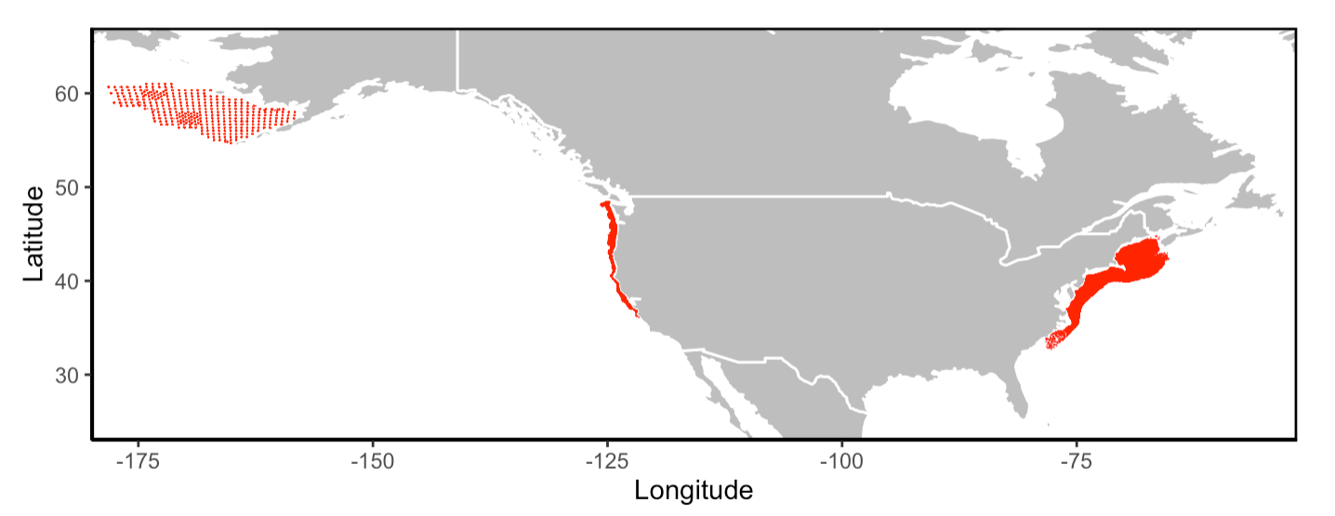
Methods for Detecting Homogenization Focal Regions
Eastern Bering Sea
1984-2018
West Coast Annual Survey
2003-2019
Northeast US
1982-2019
Notes:
Medium scale (90 km between cell centers)

Slide 19
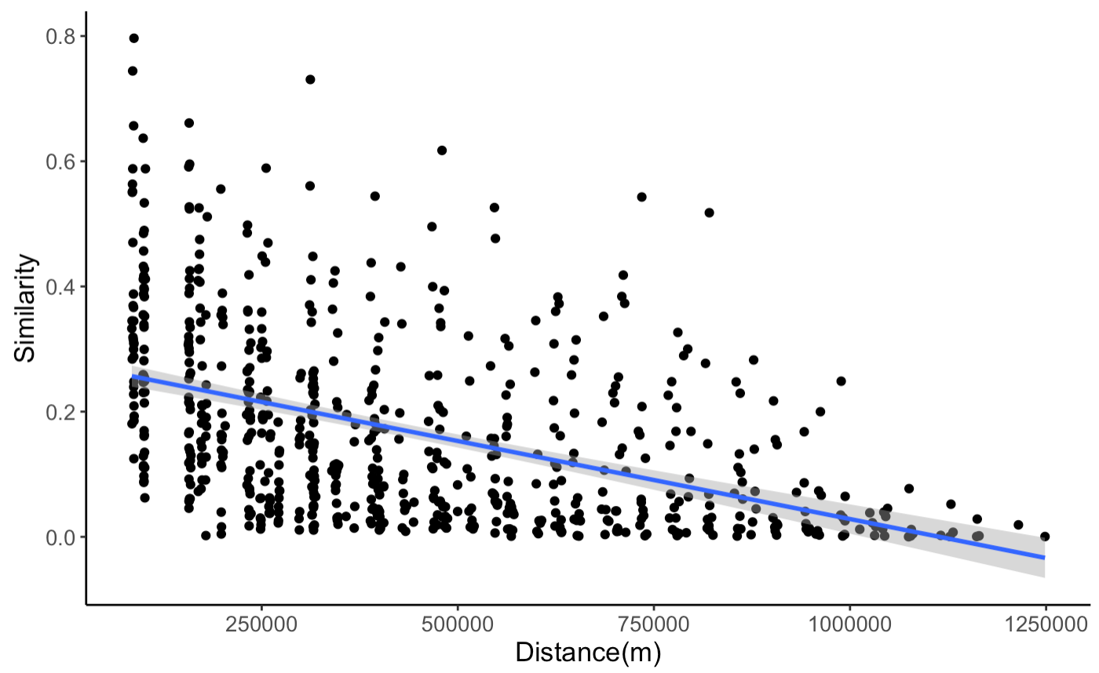
Distance*Similarity Decay Over Time
NEUS 1982
Pairwise Bray Similarity Between Sites
Steep slope: high differentiation across sites
Shallow slope: low differentiation across sites

Slide 20
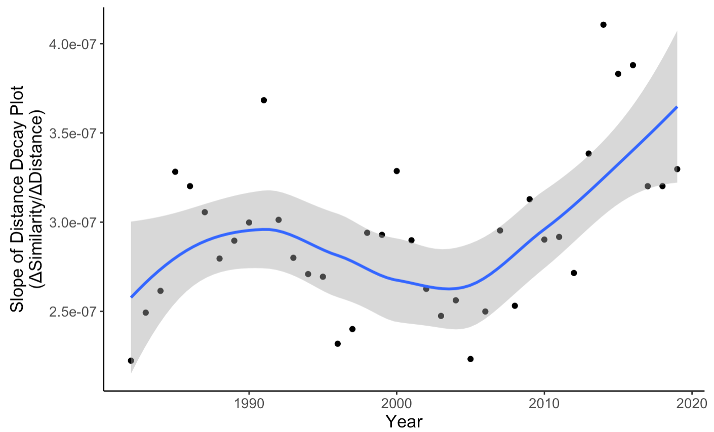
Northeast United States
Differentiation over time?

Slide 21
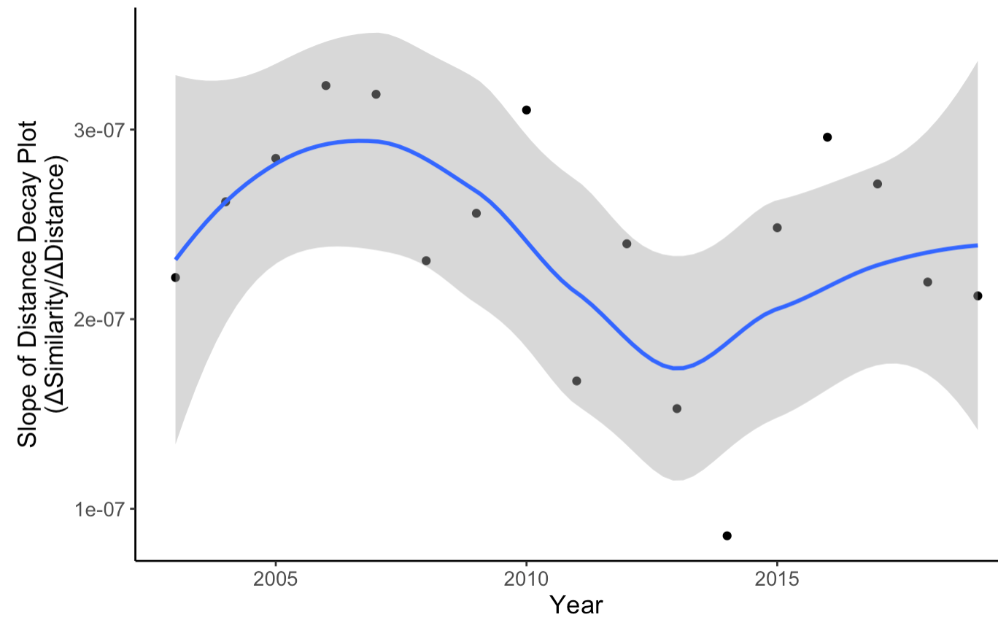
West Coast Annual Survey
No clear pattern

Slide 22
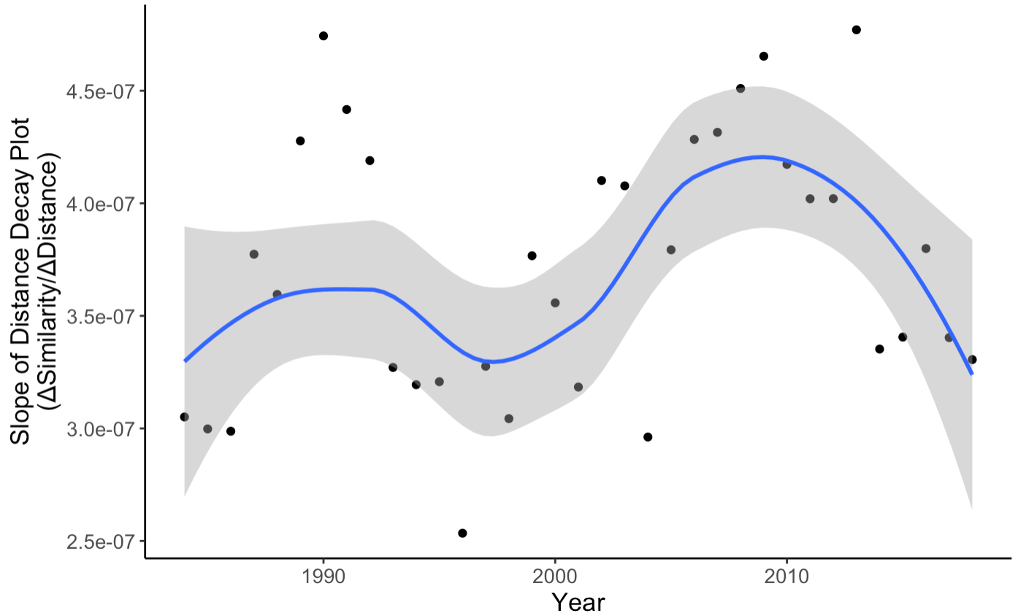
Eastern Bering Sea
No clear pattern

Slide 23
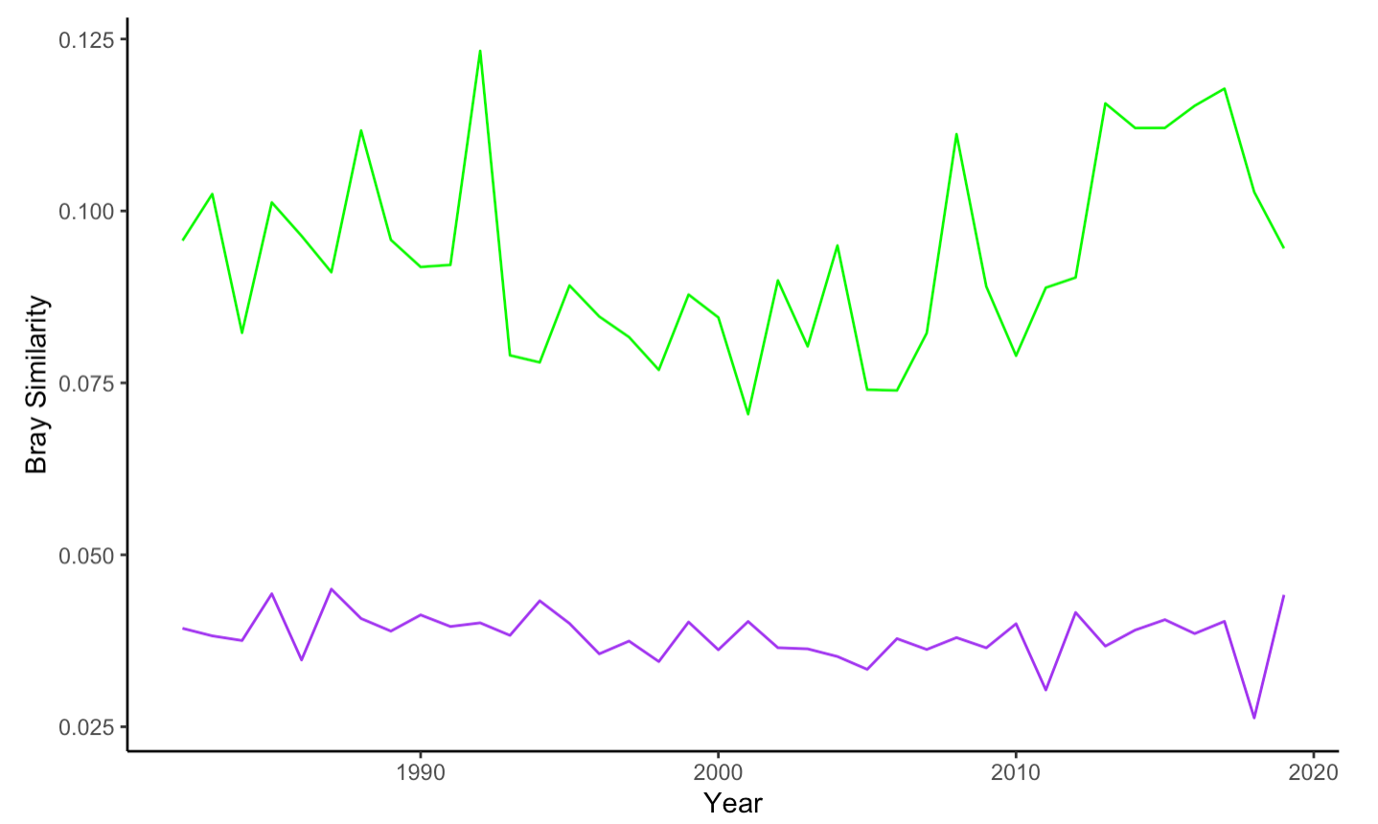
Multi-site Beta Diversity Over Time
NEUS
Balanced Component of Similarity Metric (replacement)
Overall Similarity Metric
Notes:
Balanced: individuals of some species in one site are substituted by the same number of individuals of different species in another site
Gradient: value of the abundance-gradient component of Bray-Curtis multiple-site dissimilarity (some individuals are lost from one site to the other) (nestedness)

Slide 24
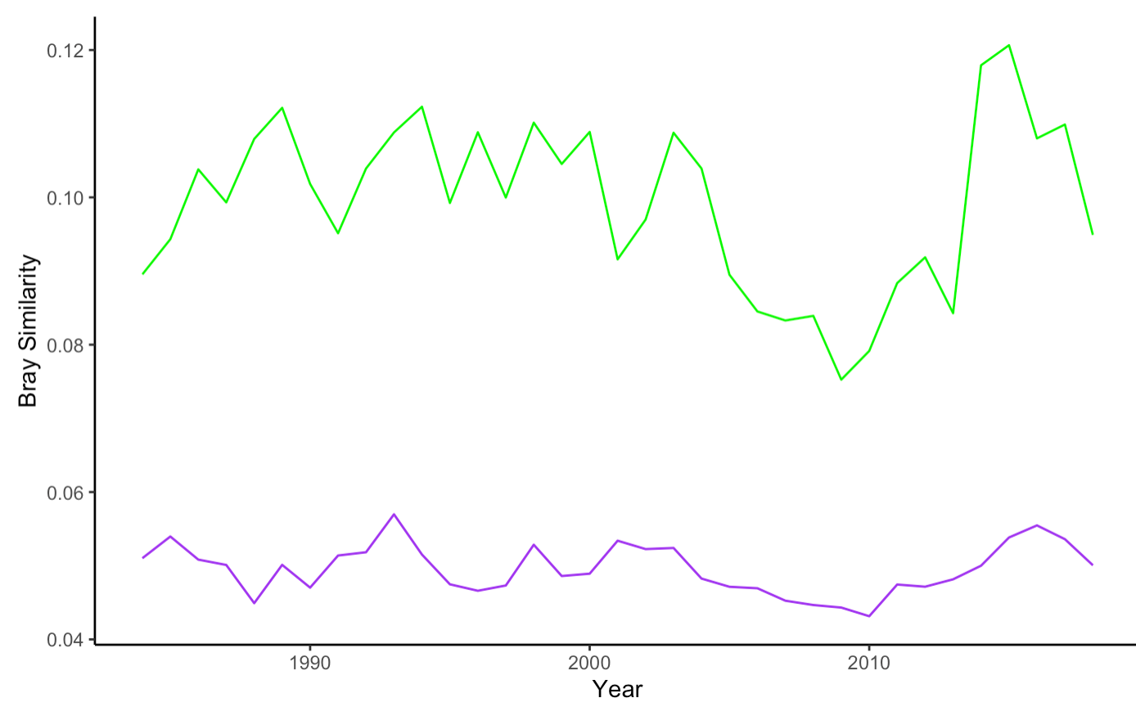
Multi-site Beta Diversity Over Time
EBS
Balanced Component of Similarity Metric (replacement)
Overall Similarity Metric
Notes:
Balanced: individuals of some species in one site are substituted by the same number of individuals of different species in another site
Gradient: value of the abundance-gradient component of Bray-Curtis multiple-site dissimilarity (some individuals are lost from one site to the other) (nestedness)

Slide 25
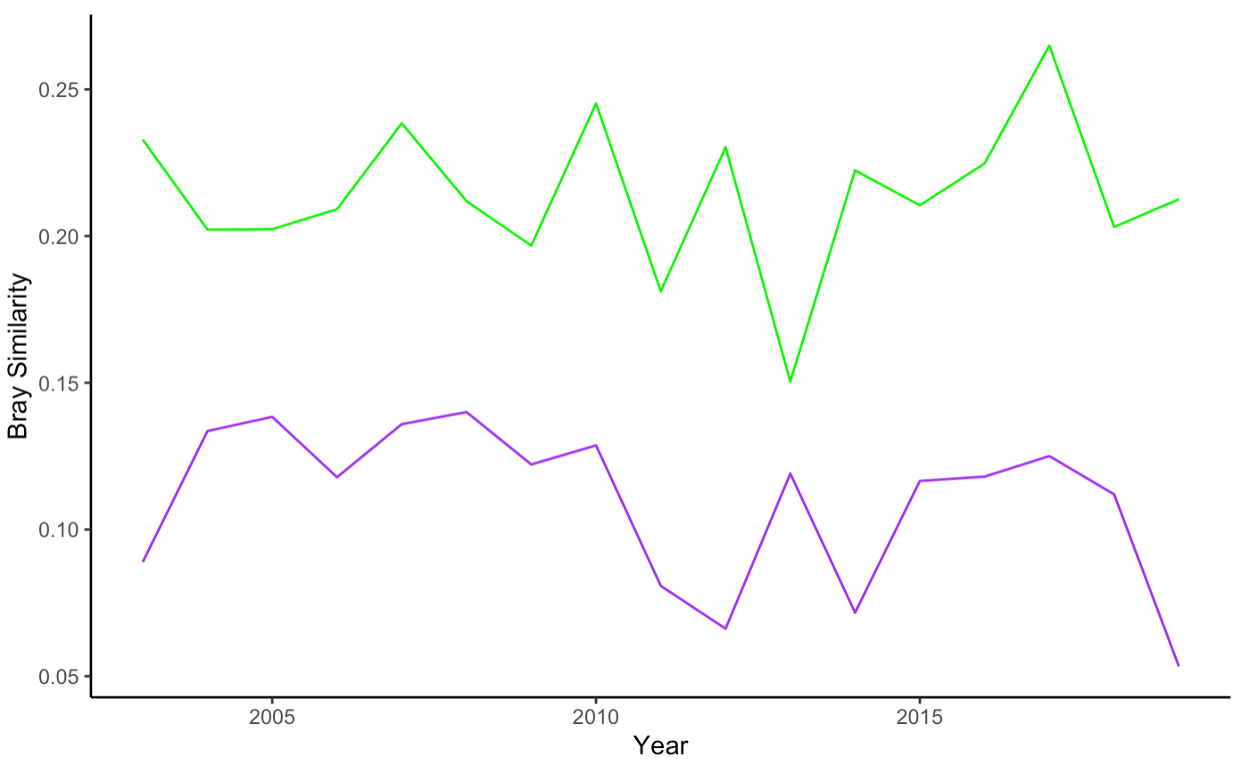
Multi-site Beta Diversity Over Time
WCANN
Balanced Component of Similarity Metric (replacement)
Overall Similarity Metric
Notes:
Balanced: individuals of some species in one site are substituted by the same number of individuals of different species in another site
Gradient: value of the abundance-gradient component of Bray-Curtis multiple-site dissimilarity (some individuals are lost from one site to the other) (nestedness)

Slide 26
Turnover versus nestedness
Temporal dissimilarity has two components with different implications, temporal nestedness (the tendency of assemblages to be subsets of one another29; TDNES) and temporal turnover (the replacement of species over time; TDTUR)30. For example, an assemblage that over time gains new species without losing any is fully temporally nested, whereas temporal turnover dominates if species gains are matched with losses—with any intermediate scenarios possible. While turnover is often a consequence of neutral dynamics or environmental sorting30, nestedness reflects a non-random process of species loss or gain as a consequence of any factor that promotes species filtering30.
Jarzyna and Jetz 2018

Slide 27
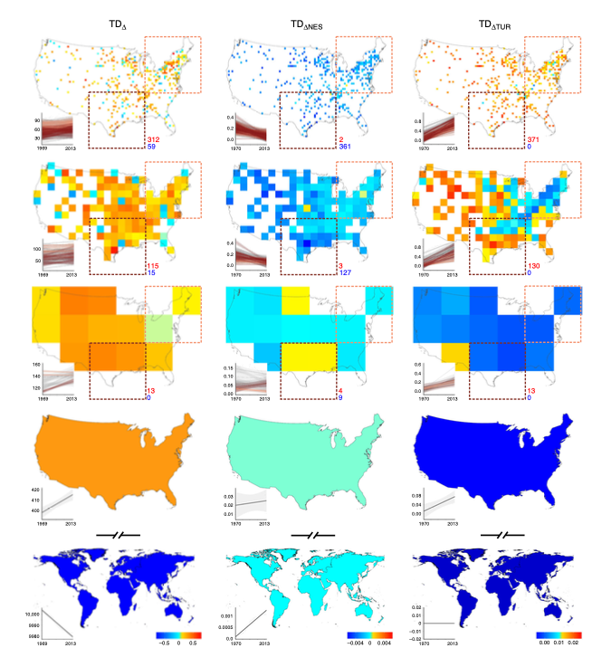
Possible Figure
Notes:
Jarzyna and Jetz 2018

Slide 28
Steps
Collect regional species abundance data for appropriate years (Batt 2017)
Find out which hauls are in which cells
Delete under-sampled cells (less than 3 hauls per year)
Rarefaction for species richness (randomly sample using species accumulation curve)
Rarefaction for beta diversity (haven’t figured this out yet, but I think it’s just randomly sampling again?)
Beta diversity across whole region per year
How does beta diversity change over time?
Another way to look at this, how do parameters of distance decay change over time?

Slide 29
Spatial trends in beta diversity through time
Homogenization versus differentiation
Beta diversity (Jaccard similarity) between all possible pairs of cells in an ocean basin
Use distance decay plots to compare decay parameters across time
Partition beta diversity into turnover & nestedness Baselga 2010 Baiser et al. 2012
Jaccard similarity
Distance between grid cells
Notes:
Beta diversity: jaccard for both presence/absence and for biomass

Slide 30
Spatial trends in beta diversity through time
Homogenization versus differentiation
Beta diversity across all cells in a region
Use distance decay plots to compare decay parameters across time
Partition beta diversity into turnover & nestedness Baselga 2010 Baiser et al. 2012
Jaccard similarity
Distance between grid cells
Notes:
Sample-based rarefaction involves randomly resampling each cell with the minimum number of samples in a cell (Blowes et al., 2019; Gotelli, Nicholas J. & Colwell, 2011). Complementing this rarefaction with coverage-based rarefaction allows us to compare samples of similar ‘completeness’, reducing the bias typically associated with low detectability of rare species (Chao et al., 2015; Chao & Jost, 2012).
Beta diversity: jaccard for both presence/absence and for biomass
Median slope of presence and absence and biomass distance decay plots over time, and then calculate ordinary least squares regressions for each. Increasing steepness of slope through time signifies differentiation, increased shallowness will signify homogenization
Partition: Furthermore, change in pairwise similarity is itself dependent on two distinct pro- cesses, spatial turnover in species composition and changes in gradients of species richness. Most past research has failed to disentangle the effect of these two mechanisms on homogenization patterns. Baiser et al 2012
Overall (broad-sense) change in similarity is driven by changes in species richness as opposed to spatial turnover. Thus, what we perceive as biotic homogenization or differentiation is largely dependent on how invasions and extinctions either diminish species richness gradients or accentuate them. Spatial turnover consistently plays a lesser role in driving patterns of community simila- rity despite this mechanism being suggested as the basis of homogenization [1]. Baiser et al 2012

Slide 31
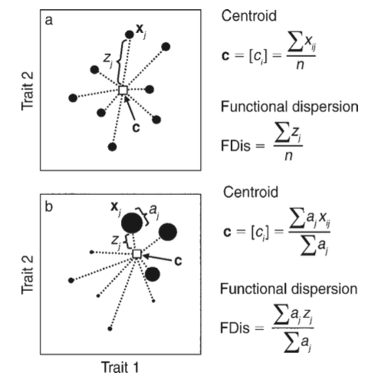
Taxonomic versus functional diversity
Fishbase
Traits: Feeding mode, trophic level, body shape, spawning type, age at maturity, maximum age, fecundity, and maximum length
Functional dispersion metric (FDis)
Assess functional spatial beta diversity through time
Laliberté and Legendre 2010
Notes:
“As I discussed earlier, to look at functional diversity, we will replace species with traits. From Baiser and Lockwood 2011: It is important to recognize that raw trait values are not compared between species in the same assemblage, or different assemblages. Change in functional similarity requires the calculation of an average value, OR a frequency of a trait, for each trait per assemblage). I will standardize continuous traits between 0 and 1.
FIG. 1. An example showing how functional dispersion (FDis) is computed. The n individual species in a two- dimensional trait space are represented by black circles whose sizes are proportional to their abundances. Vector xj represents the position of species j, vector c is the centroid of the n species (white square), zj is the distance of species j to centroid c, and aj is the abundance of species j. In panel (a), all species have equal abundances (i.e., presence–absence data). In that case, c 1⁄4 [ci], where ci is the mean value of trait i, and FDis is the mean of distances z of individual species to c. In panel (b), species have different abundances. In that case, the position of c is weighted by the species relative abundances, such that it shifts toward the more abundant species. Individual distances z of species to c are weighted by their relative abundances to compute FDis.
To characterize trait‐based community structure, we calculated community‐weighted mean trait values (CWMs) for the entire data set across all survey cells (143–154 per year) and years (33 years). CWMs are calculated as the abundance‐weighted mean trait values in the community, which result in single, numeric values for continu‐ ous traits, and proportions for categorical traits. Because CWMs as averages, they reflect relative changes in trait structure in the com‐ munity rather than absolute increases or decreases.

Slide 32
The number of available hauls within each grid cell varied from 1 to 1841 (Appendix S3) (for me in NEUS, 1 to 35). This apparent heterogeneity in sampling effort is important to standardize for, since differences in effort can bias results and potentially lead to faulty comparisons (Chao & Jost 2012). A commonly used method to assess the level of completeness of sampling is to construct species accumulation curves (SACs), where the species richness sampled is a function of the sampled area or of the number of samples. In order to standardize sampling effort across grid cells, we constructed SACs and fitted Michaelis-Menten functions to estimate the asymptotic species richness for each grid cell based on all available hauls (using the “vegan” package in R; Oksanen et al. 2017) (Appendix S3). We decided to standardize according to completeness of sampling (Chao & Jost 2012), not equal sampling effort across grid cells, to satisfy the replication principle (Hill 1973, Chao & Jost 2012). Since three samples is the minimum number of samples needed to construct a SAC, all grid cells with less than three hauls were removed prior to constructing SACs. To represent various levels of taxonomic completeness the number of samples needed to achieve 80, 65 or 50% of the estimated asymptotic species richness in each grid cell was calculated. All grid cells that did not meet the required number of samples for the desired level of completeness were removed from the analysis. As the number of discarded grid cells across the different thresholds of completeness was small, we selected the highest threshold (80% completeness) to maximize community information for each grid cell (Appendix S3). After standardization of taxonomy and trait information, and sampling coverage, a total of 1006 species from 164,397 unique hauls within 675 grid cells were included in the analysis.

Slide 33
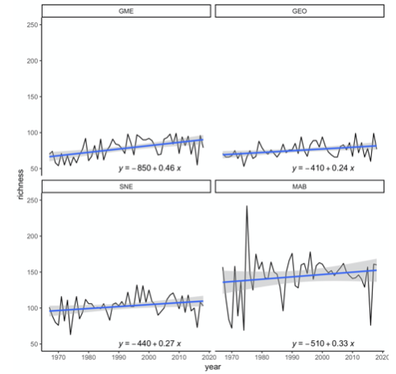
Preliminary results for NEUS (300x300km)
GME
GEO
GME
Richness
SNE
MAB
GEO
SNE
MAB
Hare et al. 2015
Year
Notes:
https://www.researchgate.net/figure/Sample-strata-and-regions-of-the-Northeast-US-Shelf-Ecosystem-Bottom-trawl-and_fig8_282129174

Slide 34
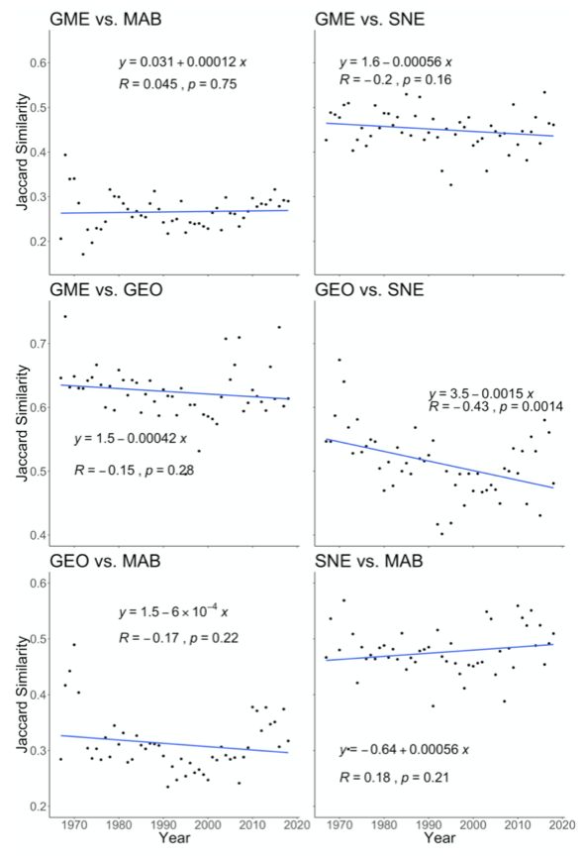
Preliminary results
GME
GEO
SNE
MAB
Hare et al. 2015
Notes:
https://www.researchgate.net/figure/Sample-strata-and-regions-of-the-Northeast-US-Shelf-Ecosystem-Bottom-trawl-and_fig8_282129174

Slide 35
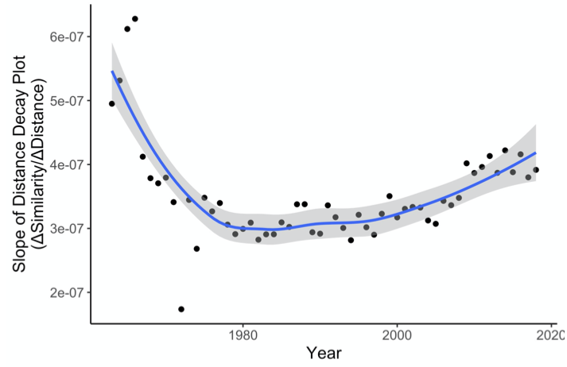
Preliminary results for NEUS (60x60km)
Steep = highly differentiated
Homogenization
Differentiation
Shallow = high similarity
Brodziak et al. 1999
Notes:
Good dataset, interesting questions. Will incorporate all regions into the future.

Slide 36
Preliminary results for NEUS (60x60km)
Steep = highly differentiated
Homogenization
Jaccard similarity
Differentiation
Shallow = high similarity
Distance between grid cells
Notes:
Good dataset, interesting questions. Will incorporate all regions into the future.

Slide 37
Next steps
Include presence absence and abundance data from US, Canada, and Western Europe
Look at patterns in functional (trait) diversity in addition to taxonomic diversity
Think more about scale
Preliminarily I looked at 60km*60km and 300km*300km, ideally I’d like to look at 10km*10km up to 1000km*1000km

Slide 38
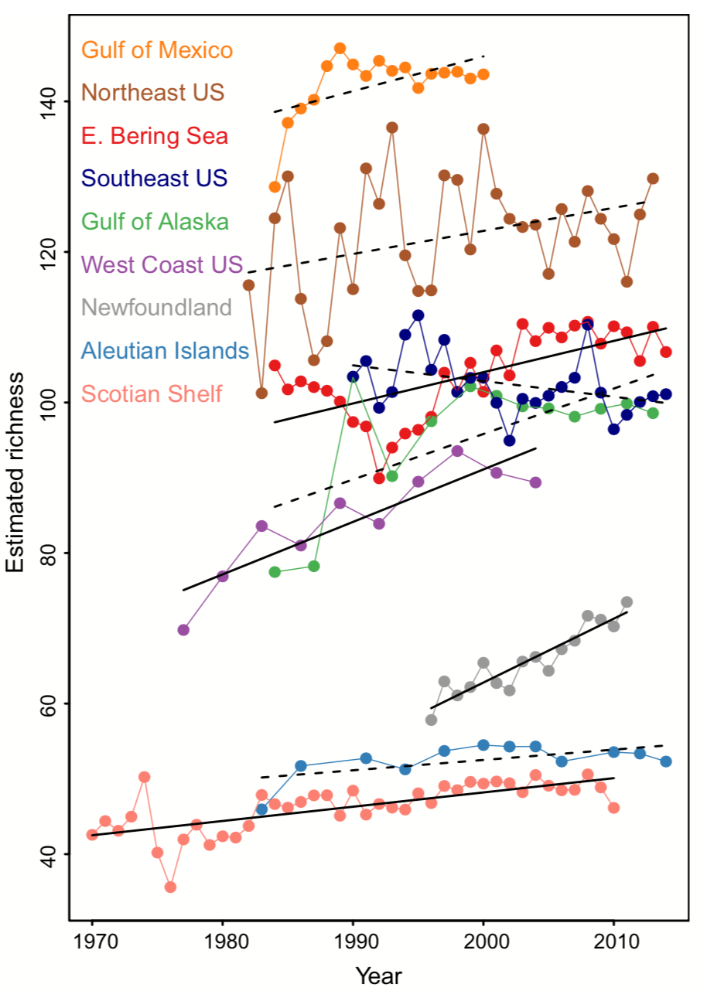
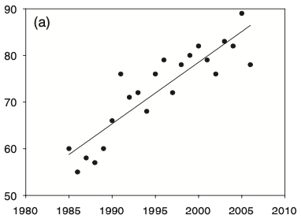
Trends in species richness in temperate marine latitudes
Richness of North Sea Fish
Batt et al. 2017
Hiddink and Hofstede 2008
Notes:
Despite global trends, many local/regional locations are increasing in richness. But, let’s dig a little deeper. What does this actually mean? What species are coming in? What (if any) are leaving?
Blowes et al 2019: biodiversity change is strongest and most variable in the oceans

Slide 39
Species richness can mask community assembly and function
Richness is limiting
Evenness
Turnover (space and time)
Taxonomic and functional diversity
Notes:
Less important how many are there, more important who is there
https://en.wikipedia.org/wiki/Remineralisation
https://commons.wikimedia.org/wiki/File:Chesapeake_Waterbird_Food_Web.jpg

Slide 40
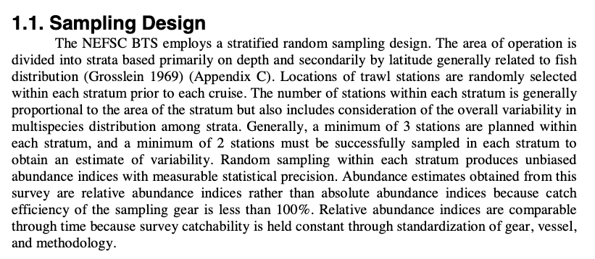
Sampling Design

Slide 41
Data
Spring survey began in 1968
Autumn began in 1963
Timing of Autumn survey stabilized starting in ~1978 *~255-320
Spring always stable from 1968 to now at ~ 60 to 140 day

Slide 42
Null Model Reshuffle ~100 times

Slide 43





Slide 44
Rarefaction
Most diversity metrics are affected by sampling effort (24), and sampling effort was often not constant throughout the time series. To prevent variation in sampling effort from obscuring temporal diversity patterns, we employed sample-based rarefaction within each time series. Specifically, we used year as the temporal grain and for each time series we found the minimum number of samples in a year.
We bootstrap resampled the data from each other year to obtain a constant number of samples through time.
Species abundances were then pooled within each year so that there was one assemblage per year per time series, and the pooled abundances were used to calculate α diversity and temporal β diversity indices. Some time series included years with an unusually low number of samples. To assess if this was causing an excessive loss of information, we individually assessed each time series and removed any years with less than half of the average number of samples prior to performing the sample based rarefaction described above. This process did not affect the results of our analysis (Figure S10) and hence only the first type of rarefaction is reported in the main text.

Slide 45
B diversity and rarefaction
In addition to α diversity metrics, we calculated measures of temporal turnover in species composition (temporal β diversity). Specifically, we calculated four metrics of turnover: (i) the Jaccard similarity index; ii) the Morisita-Horn index; iii) the Chao community similarity index, all of which were calculated using the function vegdist in vegan (28); and iv) the Pearson correlation coefficient between the abundances of each species in the two samples being compared. We report patterns of similarity for pooled abundances between each year and the first year in the time series in the main text (i.e. comparing each year to the time series baseline), and between each year and the last year of the time series (Figure S7) to ensure our results are robust to the year used to detect cumulative changes in composition.
We do not include in our analysis a comparison between the baseline year and itself (which is always equal to the maximum of the similarity metric). Negative trends in the resulting temporal beta diversity series are indicative of accumulating changes associated to diverging community composition. Positive trends are indicative of earlier steps in the time series being more different from the baseline than later time steps. This can occur, for example, as a result of cyclical variation or as a result of recovery from a disturbance immediately after the baseline year. In a stochastic system under pure white noise randomness, the trend from of the time series will be zero. However, noise generates error around zero, and hence we expect the 95% interval to include both positive and negative slopes. As an example both of the neutral model simulations we ran (Figure S8 and S9) showed some positive slopes due to a combination of these reasons. Similarities between pairs of consecutive samples (not included) were constant through time, and do not allow determining whether differences accumulate or merely fluctuate.

